Slide 1


Blockchain: The Technology Revolutionizing Industries
Blockchain is a revolutionary technology that is transforming industries around the world.
It is a secure, transparent, and decentralized system that is changing the way we think about data, transactions, and trust.
by Avinash Rao Surabhi

Slide 2

Fundamentals of Blockchain: Decentralization, Transparency, and Security
Decentralization
Transparency
Blockchain is a decentralized system, meaning it is not controlled by any single entity. It operates on a network of computers.
All transactions on a blockchain are recorded publicly and permanently. This transparency increases accountability and trust.
Security
Cryptographic techniques secure blockchain transactions, making them tamper-proof and highly resistant to fraud.

Slide 3
Applications of Blockchain: From Finance to Supply Chain Management
Finance
Supply Chain Management
Other Applications
Blockchain enables secure and efficient cryptocurrency transactions. Cryptocurrencies are digital currencies secured by cryptography.
Blockchain provides a transparent and auditable record of goods movement, improving supply chain efficiency and reducing fraud.
Blockchain is used in healthcare, voting systems, and intellectual property management.
It has the potential to transform various sectors by enhancing security, transparency, and efficiency.
It also facilitates peer-to-peer lending, decentralized exchanges, and smart contracts, revolutionizing financial services.
This technology can track products from origin to destination, ensuring authenticity and quality.

Slide 4
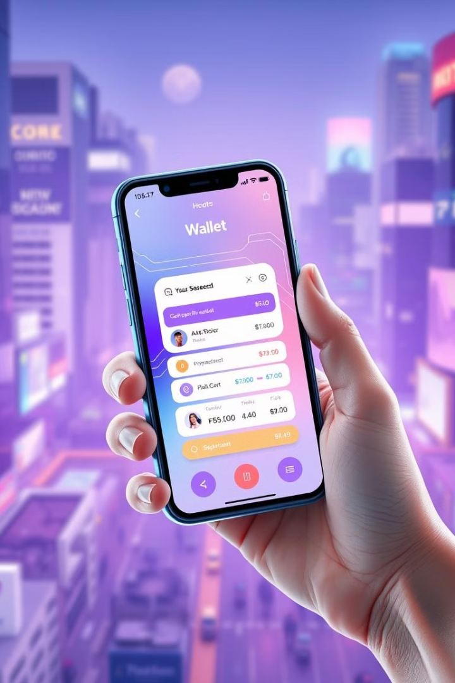
Cryptocurrencies and the Future of Digital Payments
1
Digital Currency
2
Decentralized Payments
Cryptocurrencies are digital assets secured by cryptography, operating independently of central banks.
Blockchain technology enables fast and secure peer-to-peer transactions, reducing reliance on traditional financial institutions.
3
Future of Payments
Cryptocurrencies are poised to become a significant part of the global financial system, offering new opportunities for financial inclusion and innovation.

Slide 5
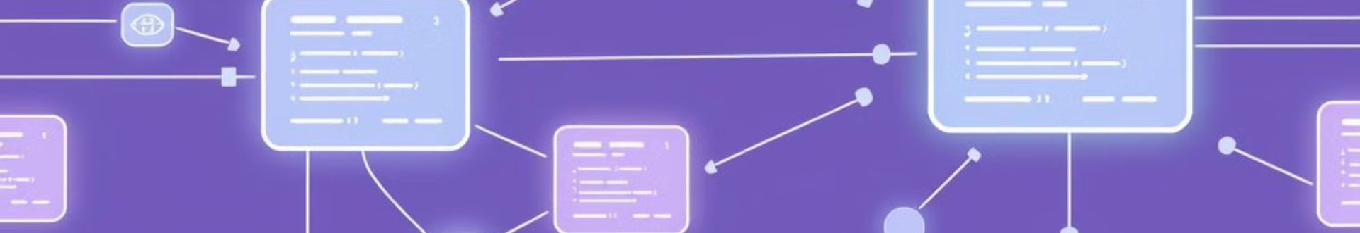
Blockchain and Smart Contracts: Automating Transactions
1
2
3
Smart Contracts
Automation
Benefits
Smart contracts are self-executing agreements written in code and stored on a blockchain.
They automate the execution of terms and conditions based on predefined rules, eliminating the need for intermediaries.
Smart contracts increase efficiency, transparency, and security in transactions.

Slide 6
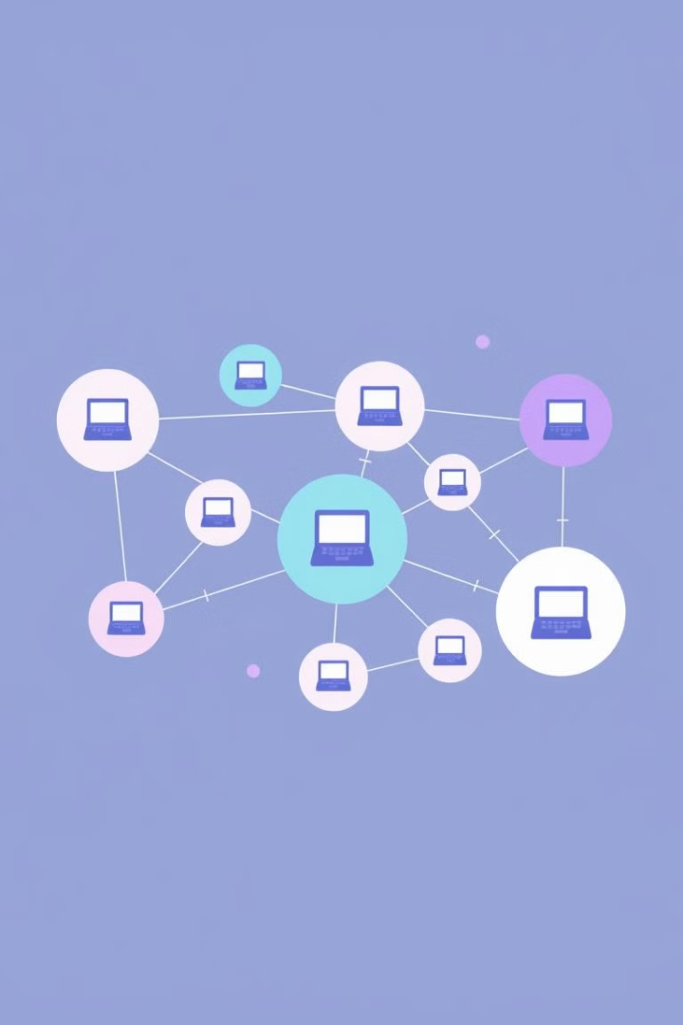



Distributed Ledger Technology: The Core of Blockchain
Distributed Ledger
A distributed ledger is a shared, immutable record of transactions that is replicated across multiple computers.
Consensus Mechanism
Nodes in the network agree on the validity of transactions using a consensus mechanism, such as proof-of-work or proof-of-stake.
Immutability
Once a transaction is recorded on a blockchain, it cannot be altered, ensuring data integrity and security.

Slide 7

Blockchain Governance and Regulation: Challenges and Opportunities
Challenges
Opportunities
Lack of clear regulatory frameworks.
Increased trust and transparency in financial markets.
Privacy concerns and data security issues.
Enhanced efficiency and cost savings in various industries.
Potential for misuse in illicit activities.
Innovation and development of new technologies and applications.

Slide 8





The Future of Blockchain: Trends and Predictions
Increased Adoption
Interoperability
More industries are expected to adopt blockchain technology, leading to broader applications and innovation.
Different blockchain platforms will become more interconnected, enabling seamless data exchange and collaboration.
Scalability
New Applications
Blockchain technology will continue to evolve to handle larger volumes of transactions and data, improving scalability and efficiency.
Blockchain will power new applications and solutions across various sectors, including healthcare, education, and government.

